Slide 1

2015 Flight Delays and Cancellations

Slide 2
Content
Dataset
Preprocessing
Questions & charts

Slide 3
Dataset
The U.S. Department of Transportation's (DOT) Bureau of Transportation Statistics tracks the on-time performance of domestic flights operated by large air carriers. Summary information on the number of on-time, delayed, canceled, and diverted flights is published in DOT's monthly Air Travel Consumer Report and in this dataset of 2015 flight delays and cancellations.

Slide 4
Preprocessing
Fill null values in CANCELLATION_REASON by 'no reason’ .
Fill null values in ARRIVAL_TIME by 'SCHEDULED_ARRIVAL’ .
Fill null values in ARRIVAL_DELAY by 'SCHEDULED_ARRIVAL - ARRIVAL_TIME ‘ .
Fill null values in DEPARTURE_TIME by 'SCHEDULED_DEPARTURE ‘ .
Fill null values in DEPARTURE_DELAY by ‘ SCHEDULED_DEPARTURE - DEPARTURE_TIME ‘ .

Slide 5
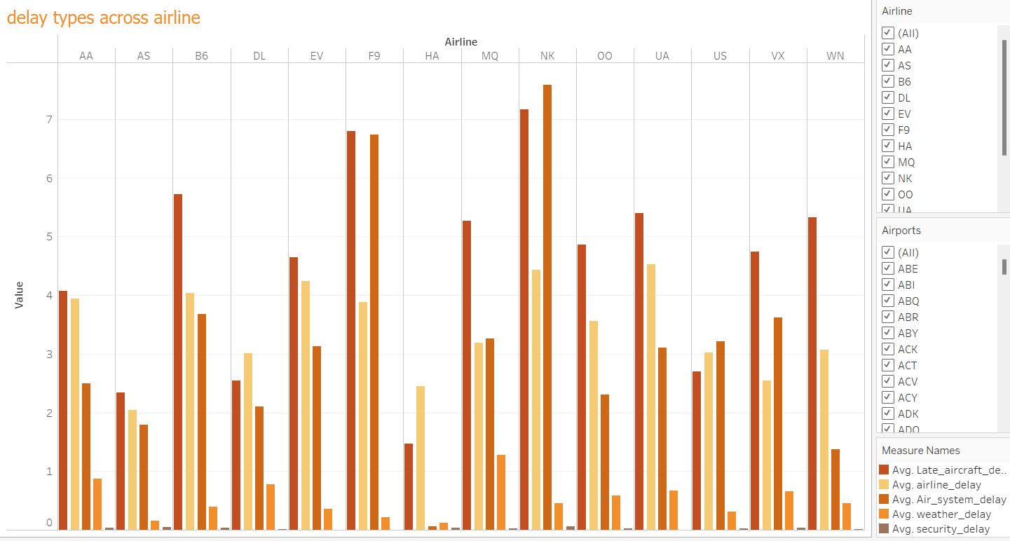
How different airlines affected by different types of delays?

Slide 6
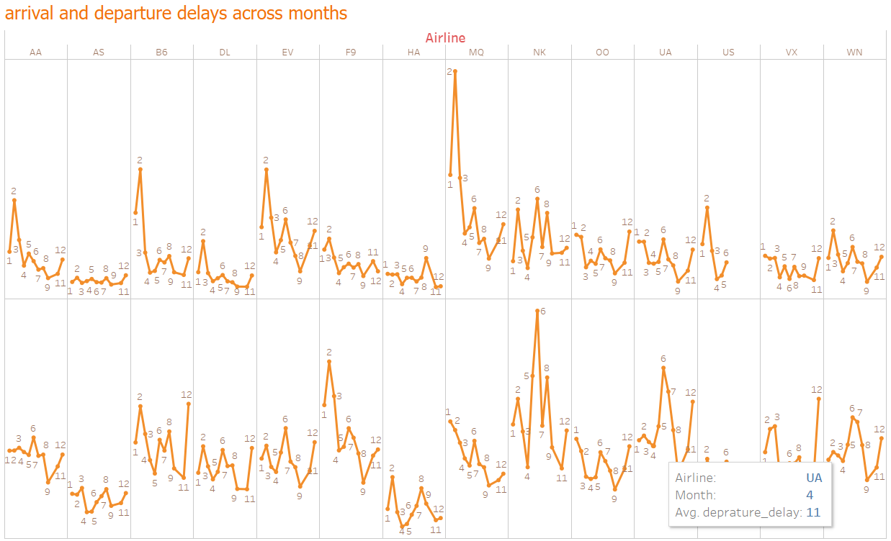
High arrival and departure delays happened in Feb & June .

Slide 7
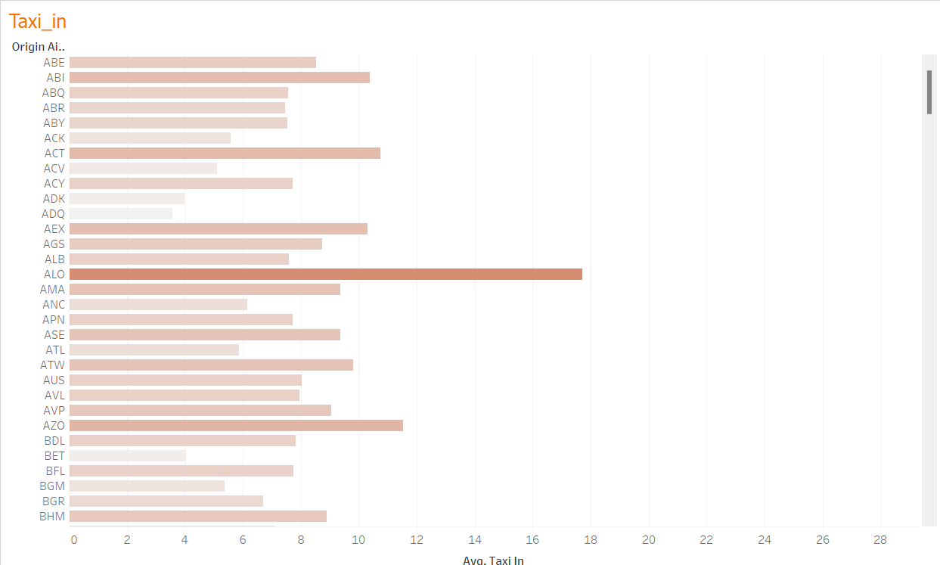
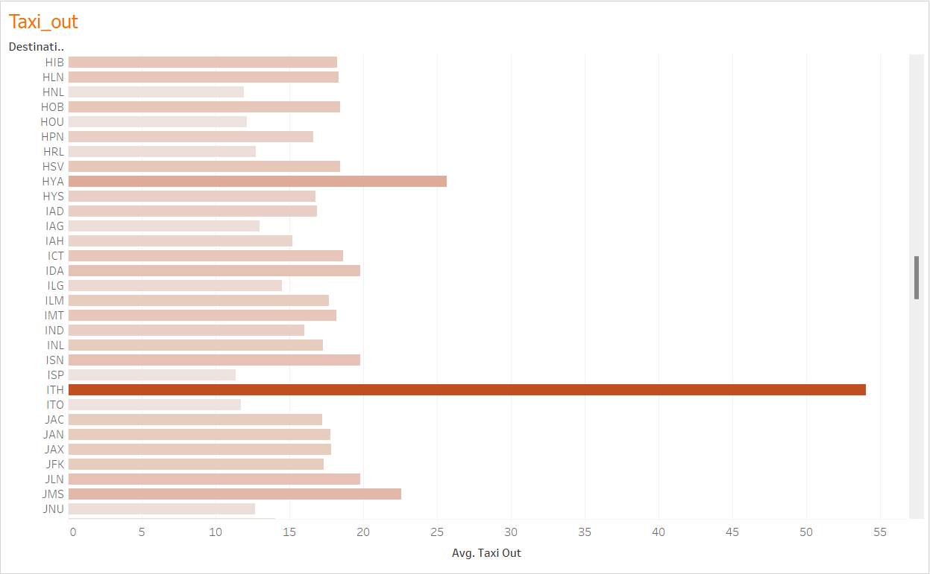
How taxi_in at origin airport & taxi_out at destination airport affected in trip delay?

Slide 8
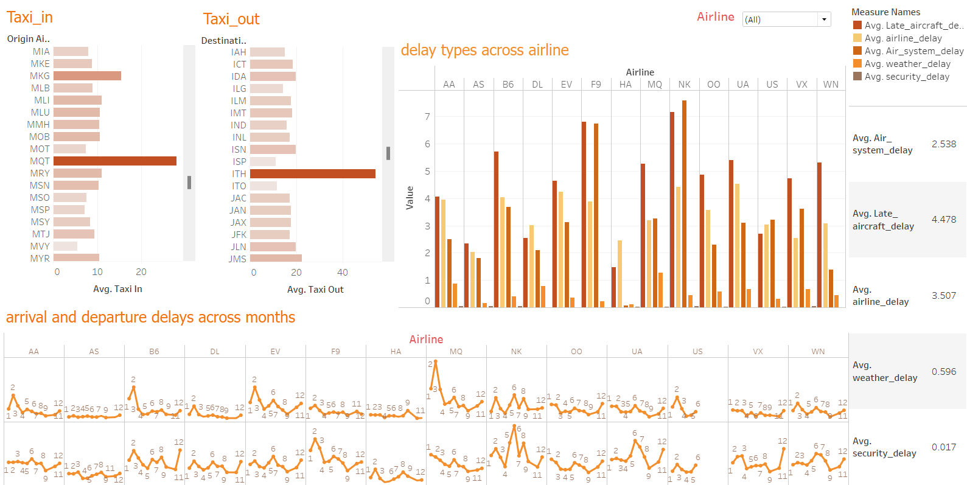
Blank slide
Link : https://public.tableau.com/views/Book2_17241350342000/dashboard2?:language=en-US&publish=yes&:sid=&:redirect=auth&:display_count=n&:origin=viz_share_link

Slide 9
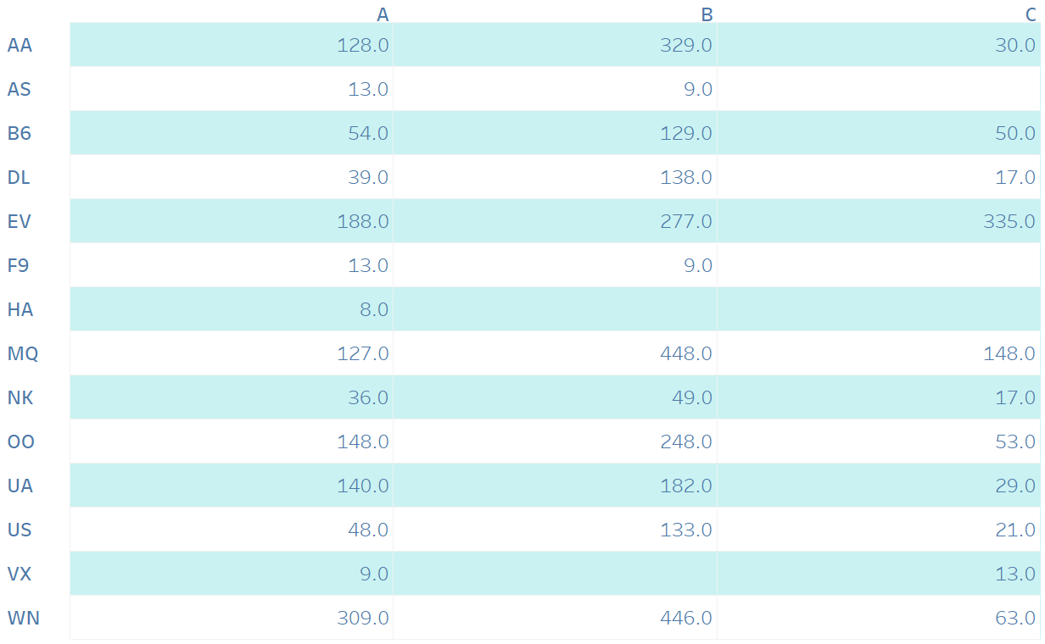
The most affected cancellation reason in the different airlines is reason B .

Slide 10
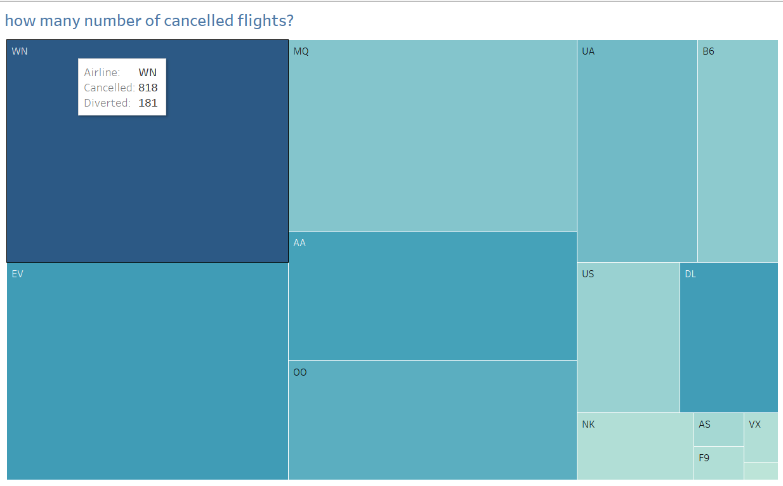
The airline that the most cancelled and diverted flights is WN .

Slide 11
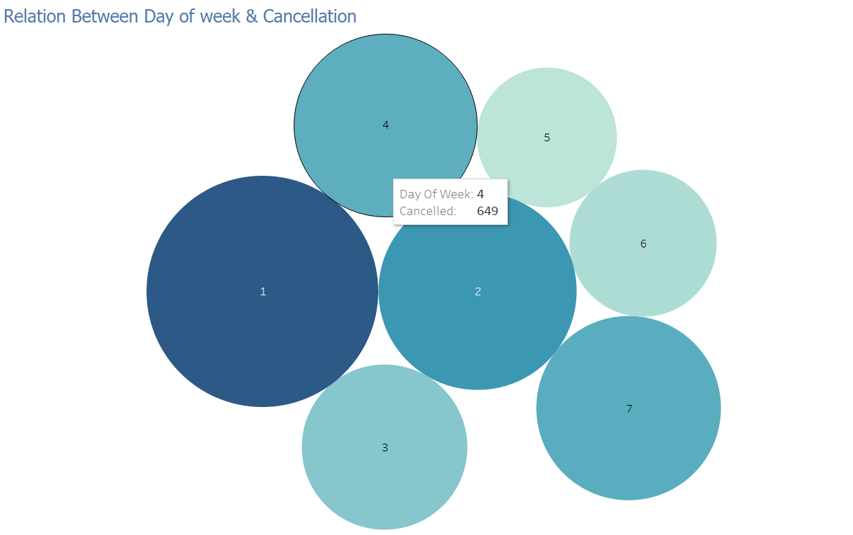
Count of cancelled flights per week day.
Most cancellation in day_1.

Slide 12
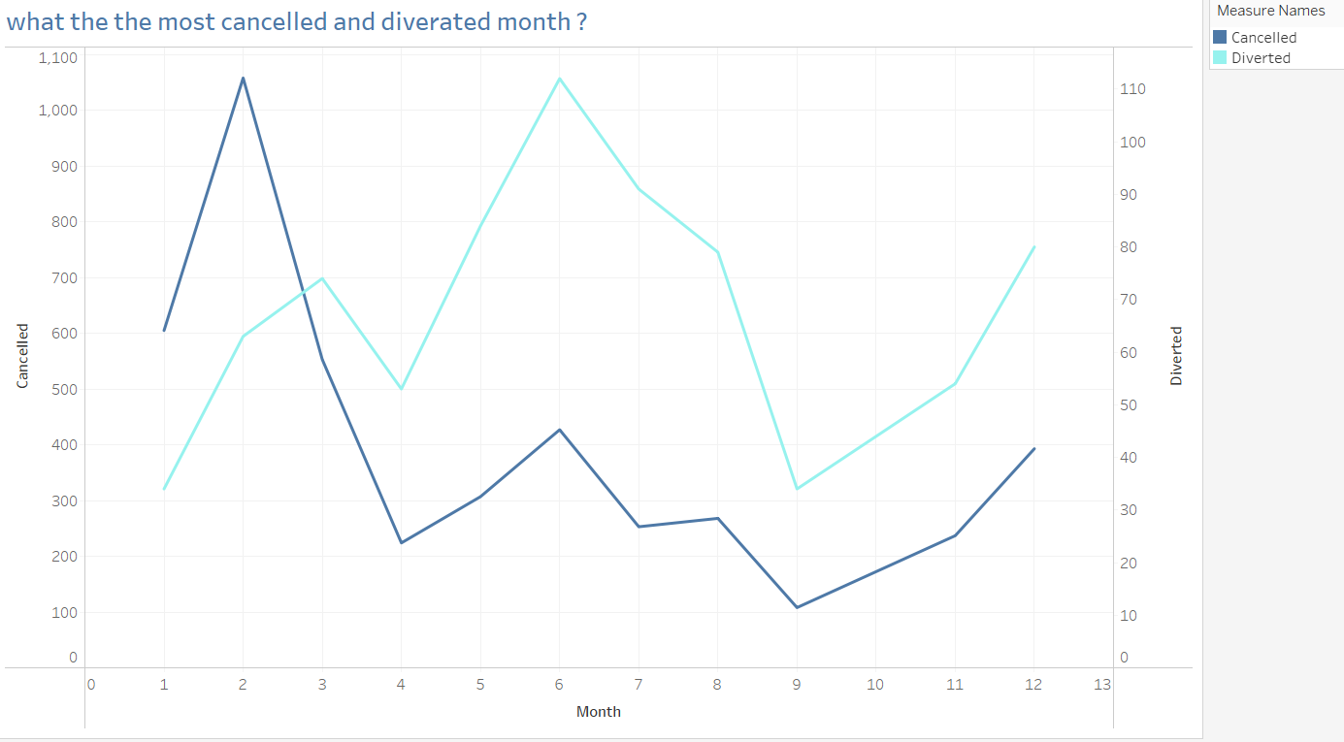
Most cancellation flights in Feb.
Most diverted flights in June.

Slide 13
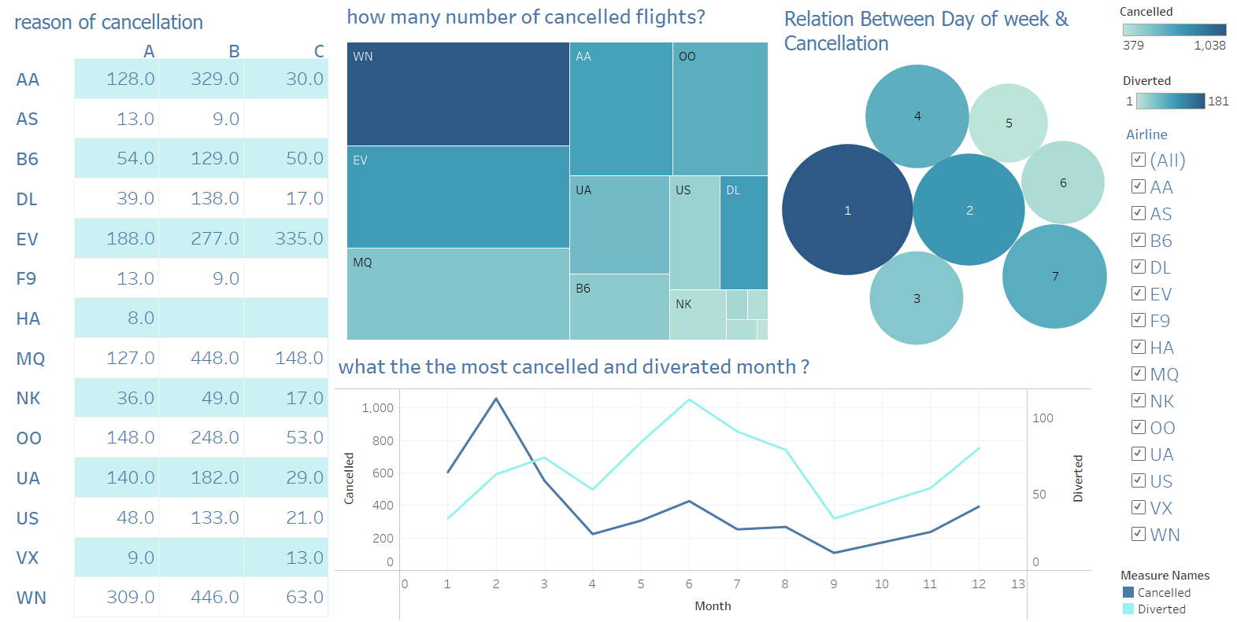
Link: https://public.tableau.com/views/Book3_17241351895840/dashboard1?:language=en-US&publish=yes&:sid=&:redirect=auth&:display_count=n&:origin=viz_share_link

Slide 14
Thank you

